Slide 1
Statistic for humanities researchers
Lecture 2: Basic concepts for statistics

Slide 2
Basic concepts in statistics
Some important statistical concepts encountered so far
1) Population
2) Sample
3) Explanation
4) Prediction
5) Within and between subjects experiments
This lecture: How are these represented as concepts in statistics
1) Frequency distributions and statistical parameters
2) Sampling distributions and sample statistics
3) The normal distribution as an explanatory statistical model
4) Hypothesis testing: z-scores, p-values, and test statistics
5) Paired and independent samples t-tests

Slide 3
Yesterday…
Concept
Theory
Construct validity
SUFFICIENCY
Operational definition
Criterion validity
Dependant variable measured in a sample
Sample
data
External validity
UNIERSALITY
Population in real world
Reliability
Population at relevant times
“Reality”

Slide 4
Yesterday…
Concept
Theory
Construct validity
Operational definition
Criterion validity
Dependent variable measured in a sample
Sample
data
External validity
Population in real world
Reliability
Population at relevant times
“Reality”

Slide 5
…today
Concept
Theory
Statistical model
Operational definition
Dependent variable measured in a sample
Sample
data
Sample
statistic
Population in real world
Hypothesis testing
Population at relevant times
“Reality”
Population statistic

Slide 6
Basic concepts in statistics
How are these represented as concepts in statistics
1) Frequency distributions and statistical parameters
2) Sampling distributions and sample statistics
3) The normal distribution as an explanatory statistical model
4) Hypothesis testing: z-scores, p-values, and test statistics
5) Paired and independent samples t-tests

Slide 7
An example
Scenario:
Psychologist employed by a mining company to measure chronic stress among employees
Research question:
Are workers at this mine suffering from chronic stress
Operational definition
Chronic stress is elevated levels of blood cortisol
Dependant variable
Blood cortisol in mcg/dL
Null hypothesis
Normal blood cortisol range = 6 - 23 mcg/dL
Mine’s workers do not have higher blood cortisol than 23 mcg/dL
Alternative hypothesis
Mine’s workers do have higher blood cortisol than 23 mcg/dL
Two ways to do the research
Collect data from all miners
Collect data from a sample

Slide 8
An example
Scenario:
Psychologist employed by a mining company to measure chronic stress among employees
Research question:
Are workers at this mine suffering from chronic stress
Operational definition
Chronic stress is elevated levels of blood cortisol
Dependant variable
Blood cortisol in mcg/dL
Null hypothesis
Normal blood cortisol range = 6 - 23 mcg/dL
Mine’s workers do not have higher blood cortisol than 23 mcg/dL
Alternative hypothesis
Mine’s workers do have higher blood cortisol than 23 mcg/dL
Two ways to do the research
Collect data from all miners
Collect data from a sample

Slide 9
Population – everyone at the mine
Population cortisol
x₁ = 14
x₂ = 24
x₃ = 17
x₄ = 24
x₅ = 18
x₆ = 23
x₇ = 31
x₈ = 31
x₉ = 27
x₁₀ = 24
…..
x₄₈ = 24
x₁ = his cortisol level
x₃ = his cortisol level
x₂ = her cortisol level
How can we represent this data?

Slide 10
Basic concepts in statistics
Frequency
How often does a type of score occur?
How frequent is a type of score?
MINING DATA
0-5:
6-10:
11-15: +
16-20: +++++++++
21-25: ++++++++++++++++++
26-30: ++++++++++++++
31-35: ++++++
36-40: +
41-45:
Frequency distribution
A plot representing how often each type of score occurs
A histogram
0-5
6-10
11-15
16-20
21-25
26-30
31-35
36-40

Slide 11
Population – everyone at the mine
Population cortisol
x₁ = 14
x₂ = 24
x₃ = 17
x₄ = 24
x₅ = 18
x₆ = 23
x₇ = 31
x₈ = 31
x₉ = 27
x₁₀ = 24
…..
x₄₈ = 24
x₁ = his cortisol level
x₃ = his cortisol level
x₂ = her cortisol level
Is there a more concise way to represent this data?

Slide 12
Population – everyone at the mine
Population cortisol
x₁ = 14
x₂ = 24
x₃ = 17
x₄ = 24
x₅ = 18
x₆ = 23
x₇ = 31
x₈ = 31
x₉ = 27
x₁₀ = 24
…..
x₄₈ = 24
x₁ = his cortisol level
x₃ = his cortisol level
x₂ = her cortisol level
Population mean
Average = add up all the scores, and divide by the number of scores
i.e. (x₁+ x₂ + x₃+ x₄ …+ x₄₈) /48
Equation to calculate population mean
Statistical Parameter
Add everything
Generally: A parameter is a number that represents something about a population by describing its distribution.
Population mean
μ= 24.48
“ith” score
No. subjects

Slide 13
Mean
Tells us roughly the centre of distribution – at least for the kind of distribution we will be talking about

Slide 14
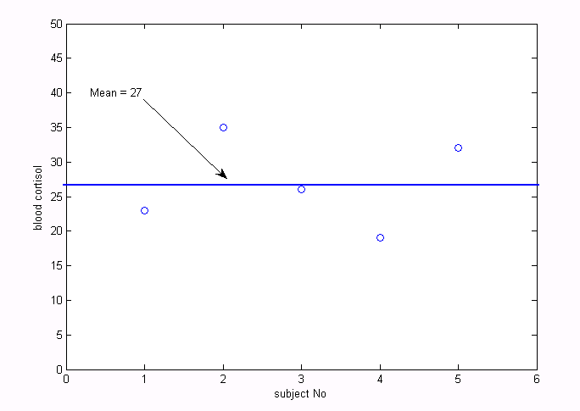
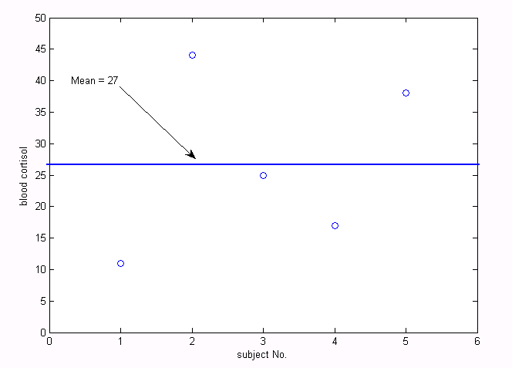
But how much does the mean represent?
Is there more we need to know?
Let’s look at some smaller populations:
Population 1
x₁ = 23 mg/dL
x₂ = 35 mg/dL
x₃ = 26 mg/dL
x₄ = 19 mg/dL
x₅ = 32 mg/dL
Population 2
x₁ = 11 mg/dL
x₂ = 44 mg/dL
x₃ = 25 mg/dL
x₄ = 17 mg/dL
x₅ = 38 mg/dL
Same mean, different distribution…

Slide 15
Mean
About the centre of distribution – at least for the kind of distribution we will be talking about
What about the shape of the distribution. How do we represent that??

Slide 16
Basic concepts in statistics
Standard deviation tells us:
The shape of a distribution
How spread out the scores are
How much variability there is between scores
The average (i.e. standard) distance (i.e. deviation) of each score from the mean

Slide 17
The average (i.e. standard) distance (i.e. deviation) of each score from the mean
We need to know
Distance from x₁to µ +
Distance from x₂ to µ +
Distance from x₃ to µ +
Distance from x₄ to µ +
Distance from x₅ to µ/
n
SD = 6.52
We could calculate
(27-23) +
(35-27) +
(27-26) +
(27-19) +
(32-27)
/5 = 6.52
Sample 1
x₁ = 23
x₂ = 35
x₃ = 26
x₄ = 19
x₅ = 32
µ = 27
n = 5
µand x_{n}keep switching sides on the minus sign
But this is too inefficient
we can’t turn this into a general equation!

Slide 18
The average (i.e. standard) distance (i.e. deviation) of each score from the mean
To avoid this we
(x₁–µ)² +
(x₂ – µ)² +
(x₃ – µ)² +
(x₄ – µ)² +
(x₅ – µ)² /
n
SD = 6.52
What are we doing
Squaring the difference between the scores and the mean
Square makes everything the same sign
But this gives us the square of the summed differences
Sum of squared errors/n
Variance
So to finish we
Take the square root (√)
i.e. we “unsquare” everything
Sample 1
x₁ = 23
x₂ = 35
x₃ = 26
x₄ = 19
x₅ = 32
µ = 27
n = 5
Square root of the sum of squared errors, divided by n

Slide 19
Mean
Tells us roughly the centre of distribution – at least for the kind of distribution we will be talking about
Standard deviation
Tells us the shape of the distribution – at least for the kind of distribution we will be talking about

Slide 20
Basic concepts in statistics
How are these represented as concepts in statistics
1) Frequency distributions and statistical parameters
2) Sampling distributions and sample statistics
3) The normal distribution as an explanatory statistical model
4) Hypothesis testing: z-scores, p-values, and test statistics
5) Paired and independent samples t-tests

Slide 21
An example
Scenario:
Sociologist employed by a mining company to measure chronic stress among employees
Research question:
Are workers at this mine suffering from chronic stress
Operational definition
Chronic stress is elevated levels of blood cortisol
Dependant variable
Blood cortisol in mcg/dL
Null hypothesis
Normal blood cortisol range = 6 - 23 mcg/dL
Mine’s workers do not have higher blood cortisol than 23 mcg/dL
Alternative hypothesis
Mine’s workers do have higher blood cortisol than 23 mcg/dL
Two ways to do the research
Collect data from all miners
Collect data from a sample

Slide 22
Population
n = 48
Sample scores
x₁ = 31
x₂ = 31
x₃ = 27
x₄ = 24
x₅ = 24
x₆ = 34
x₇ = 28
x₈ = 21
x₉ = 21
x₁₀ = 26
x₁₁ = 24
x₁₂ = 35
x₁₃ = 25
x₁₄ = 27
x₁₅ = 22
x₁₆ = 20
Sample
n = 16
Parameter
Population mean
Sample average
Average = add up all the scores, and divide by the number of scores
i.e. (x₁+ x₂ + x₃+ x₄ …+ x₁₆) /16
Parameter Estimate
Sample mean
Population mean = average score of population
Sample mean = estimation of average score based on the sample
= 26.25

Slide 23
Population
n = 48
Sample scores
x₁ = 31
x₂ = 31
x₃ = 27
x₄ = 24
x₅ = 24
x₆ = 34
x₇ = 28
x₈ = 21
x₉ = 21
x₁₀ = 26
x₁₁ = 24
x₁₂ = 35
x₁₃ = 25
x₁₄ = 27
x₁₅ = 22
x₁₆ = 20
Sample
n = 16
Parameter
Population mean
Sample average
Average = add up all the scores, and divide by the number of scores
i.e. (x₁+ x₂ + x₃+ x₄ …+ x₁₆) /16
Parameter Estimate
Sample mean
Generally: a parameter estimate is a guess about a population’s parameter, from knowledge of the sample
= 26.25

Slide 24
Sample standard deviation
σis the population standard deviation, a parameter
s is the sample standard deviation, a parameter estimate, based on our knowledge of the sample
Sample mean
(Number of scores) - 1
Why n - 1?

Slide 25
Degrees of freedom
When we calculate a parameter in a population
We have all the information we need
When we use a parameter estimate to estimate a population parameter
We make a guess with incomplete information
Sometimes this guess involves assuming certain other parameters can’t change
E.g. an estimation of standard deviation assumes a certain mean
Therefore we need to
Adjust our estimation, based on how many parameters we need to assume
We do this when we calculate standard deviation by
Using n - 1 for standard deviation
- 1 because we assume 1 parameter
This concept will come up again
See Field, p36 &wikipediadegrees of freedom for further explanation

Slide 26
Evaluating parameter estimates
Parameter estimates can be better or worse
In our case, parameter µ = 24.48, parameter estimate x = 26.25
What makes a parameter estimate better or worse
Representativeness of sample
Think back to external validity – Truman election
Sample size
Bigger samples give better parameter estimates

Slide 27
Population
Sample

Slide 28
Population
Sample size 1

Slide 29
Population
Sample size 2

Slide 30
Population
Sample size 3

Slide 31
Population
Sample size 4

Slide 32
Population
Sample size 4
The smaller the sample
the less information
the worse the parameter estimate

Slide 33
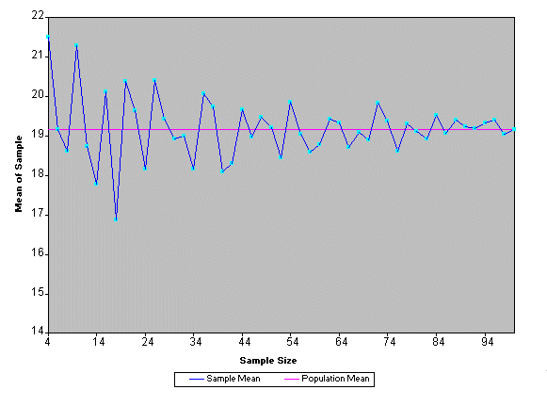
The central limit theorem

Slide 34
How good is my parameter estimate?
Consequence of the central limit theorem:
Parameter estimate will be inaccurate whenever the sample is smaller than the population
Bigger sample is better, but you can never be sure
But if I can’t be sure my parameter estimate is good, can I at least estimate how good it is?
How dependable are my data?
Does what I learn about my sample generalise to the population?
Does my experiment satisfy the criterion of universality?
Can we estimate this?

Slide 35
How good is my parameter estimate?
Use the standard error
Statistic to estimate how well your parameter estimate (sample) represents the parameter (population)
Great, what is the standard error?
Standard deviation of the sampling distribution
Great, what is a sampling distribution…
But if I can’t be sure my parameter estimate is good, can I at least estimate how good it is?
How dependable are my data?
Does what I learn about my sample generalise to the population?
Does my experiment satisfy the criterion of universality?
Can we estimate this?

Slide 36
Sampling distribution
Frequency distribution
A plot representing how often each type of score occurs

Slide 37
Sample 1:
Mean = 27.16
Sample 2:
Mean = 25.67
Population: mean = 24.48mg/dL cortisol
Sample 3…
Sample 40…
…
Sample 6…
Sample 5…
Sample 4…

Slide 38
Sampling distribution
Frequency distribution
A plot representing how often each type of score occurs
Sampling distribution
A plot representing how often each type ofsample mean occurs

Slide 39
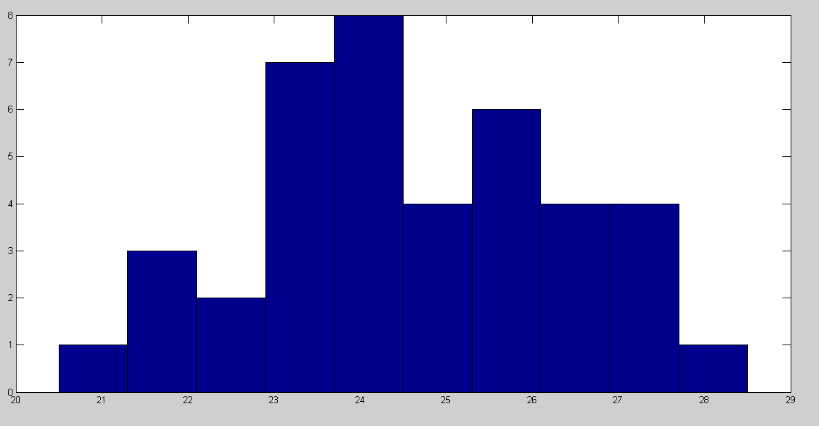
Population mean = 24.48
Mean of sampling dist. = 24.60
Mean of the sampling distribution – should be close to population mean – lots of samples = lots of experiments
Standard deviation
Tells us the shape of the sampling distribution
Standard error of the mean
Gives an estimate of how closely our sample mean represents the population
Tells us how much variability there is between samples

Slide 40
Two ways to calculate the standard error
Take lots and lots of samples
Make a sampling distribution
Find the standard deviation of that distribution
Standard error of the sample mean
Sample standard deviation
=
Square root of the number of subjects
What does this tell us:
Small SE → not much variability between sample means → parameter estimate is good

Slide 41
Basic concepts in statistics
How are these represented as concepts in statistics
1) Frequency distributions and statistical parameters
2) Sampling distributions and sample statistics
3) The normal distribution as an explanatory statistical model
4) Hypothesis testing: z-scores, p-values, and test statistics
5) Paired and independent samples t-tests

Slide 42
Basic concepts in statistics
Let’s say we have a decent sample, and decent parameter estimates (low standard error)…..
…..can we start to make inferences about our population, based on our sample of measurements?
Not yet. First we need a statistical model….
A mathematical expression of the relationships we postulate to exist between the parameters
Why do we need this?

Slide 43
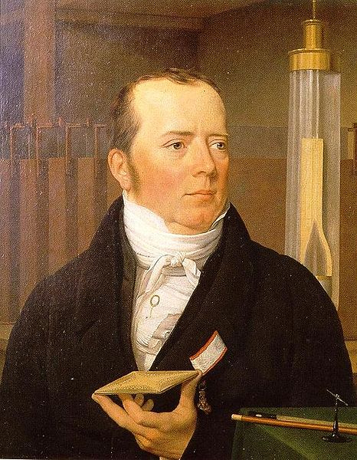
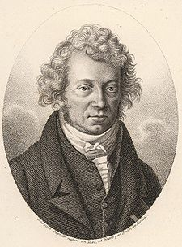
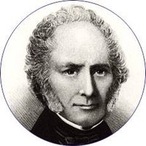
Basic concepts in statistics
Observation
See a phenomenon in the world
E.g. electric fields induce magnetic changes
Explanation
Construct a theoretical account
E.g. theory of electrodynamics
Prediction
Use the theory to predict new and surprising phenomena
E.g. moving charge induces a magnetic field
Control
Harness the new knowledge to better the lot of humanity
E.g. electric motor
Role of the model:
expression of theory

Slide 44
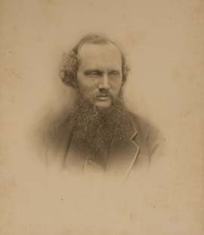
Basic concepts in statistics
Mechanical model
Description of a physical phenomenon in terms of its most relevant physical properties
Where relevant is defined relative to a explanatory or predictive goal
Statistical model
Description of a phenomenon in terms of its most relevant statistical parameters
“I am never content until I have constructed a mechanical model of the subject I am studying. If I succeed in making one, I understand; otherwise I do not.” Kelvin

Slide 45
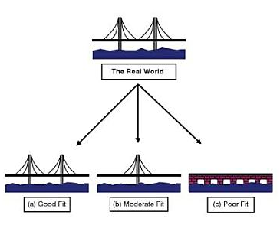
Field’s example of a physical model
Engineering task
Build a bridge
First step
Construct a physical model for testing
Requirement
Right physical properties
Right conditions

Slide 46
Basic concepts in statistics
Mechanical model
Description of a physical phenomenon in terms of its most relevant physical properties
Where relevant is defined relative to a pragmatic or explanatory goal
Statistical model
Description of a phenomenon in terms of its most relevant statistical parameters
“I am never content until I have constructed a mechanical model of the subject I am studying. If I succeed in making one, I understand; otherwise I do not.”

Slide 47
Field’s example
Engineering task
Build a bridge
First step
Construct a physical model for testing
Requirement
Right physical properties
Right conditions
Research task
Explain something
First step
Construct a statistical model
Requirement
Good parameter estimates
Minimise confounds, right manipulations, etc.

Slide 48
Statistical models
We need models to…
Postulate relationship between parameter estimates
Postulate relationship between sample and population
Formulate and test hypotheses

Slide 49
Statistical models are models of probability
Frequency
How often a score occurs in a population/sample
E.g. blood cortisol level of 16-20 mcg/dL occurs 9 times
Probability
How likely a score is to occur in the population
E.g. 16-20 mcg/dL occurs 9 times
9/48 times
9/48 x 100 = 18.75%
p(16-20) = 0.1875

Slide 50
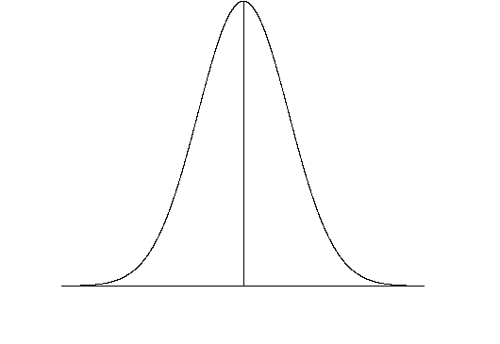
Probability distributions
Frequency distribution
A plot representing how often each score occurs
Probability distribution
A plot representing how likely each score is to occur
(Probability density function)

Slide 51
Probability distributions
Numerical representation of probability
Definitely happen = 1
Won’t happen = 0
0 → 1 = chance of happening
E.g. p(rolling a 4) = ¼ = .167
So how does a probability distribution represent
Chance of each value occurring

Slide 52
Probability distributions
Area under entire curve = 1
Probability of getting some score = 1
probability
Probability of single score represented as a point on the curve
Probability of a range of scores represented as area under the curve between points
E.g. p(16-20) = .1875
score

Slide 53
Probability distributions
Mean: centre of the distribution
Mean: centre of the distribution
Standard deviation: shape of the distribution
Standard deviation: shape of the distribution

Slide 54
Normal distribution
Normal distribution: a probability distribution where:
The mean is equal to the centre of the distribution
1 standard deviation is = 34% of the values
1 standard deviation = 34% of the area under the curve
Mean
Standard deviation

Slide 55
Normal distribution as a model
How do we relate the mean and standard deviation mathematically
How is the normal distribution a statistical model
We can write an equation that includes only the mean and standard deviation but that fully describes the distribution
Gaussian function

Slide 56

The normal distribution is a very important statistical model
Because:
It is very common
Most random natural processes are normally distributed
All the good statistics assume data are normally distributed

Slide 57
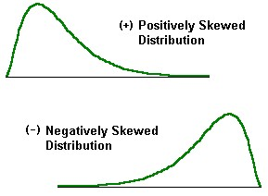
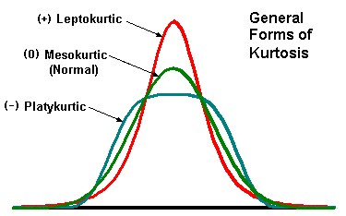
Deviations from normality
Skew
Distribution is not centred
Differences in mean
Kurtosis
Change in dispersion
Differences in standard deviation
We will look more closely at this topic in the lab

Slide 58
Basic concepts in statistics
How are these represented as concepts in statistics
1) Frequency distributions and statistical parameters
2) Sampling distributions and sample statistics
3) The normal distribution as a parametric model
4) Hypothesis testing: z-scores, p-values, and test statistics
5) Paired and independent samples t-tests

Slide 59
The problem
If frequency distribution is the same shape as the normal distribution,
possible to infer the probability of getting a certain score in the sample
area under the curve
But this doesn’t tell us about the probability of getting a certain score in the population
How do we use the normal distribution to infer from the sample to the population?
When does the statistical model do its job?

Slide 60
The problem
If frequency distribution is the same shape as the normal distribution,
possible to infer the probability of getting a certain score in the sample
area under the curve
But this doesn’t tell us about the probability of getting a certain score in the population
How do we use the normal distribution to infer from the sample to the population?
When does the statistical model do its job?
Pure statisticians have made statistical tables that you can look up
So you don’t have to know the Gaussian function
These assume data come from a standard normal distribution
A mean (centre) of 0, and a standard deviation (shape) of 1.
But what if our data isn’t like this?
Who’s is

Slide 61
The solution
Z-score: converts measured frequency distribution into a standard normal distribution
Standardises the scores
Transforms the score so that it is in units of standard deviation
E.g. 28 mcg/dL blood cortisol→x standard deviations above the mean
Sample mean
Score
Sample standard deviation

Slide 62
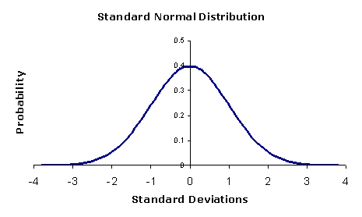
The solution
Question about the sample
How likely is a given score in a sample
E.g. 16-20 mcg/dL blood cortisol?
p(16-20) = .1875
Question about the population
How likely is a given z-score
E.g. how likely are scores that are greater than 2 standard deviations above the mean
p = .16 (we can look this up in a table
So….
If our data are normally distributed
And we have good parameter estimates
We can use z-scores to infer the probability of getting certain values in the population
p-value: keyconcept in statistics
Will come up again

Slide 63
Back to the example – we can almost test our hypothesis
Scenario:
Sociologist employed by a mining company to measure chronic stress among employees
Research question:
Are workers at this mine suffering from chronic stress
Operational definition
Chronic stress is elevated levels of blood cortisol
Dependant variable
Blood cortisol in mcg/dL
Null hypothesis
Normal blood cortisol range = 6 - 23 mcg/dL
Mine’s workers do not have higher blood cortisol than 23 mcg/dL
Alternative hypothesis
Mine’s workers do have higher blood cortisol than 23 mcg/dL
-z-scores alone can’t distinguish these
-only tell the probability of a given score
-we need one more statistic!!!

Slide 64
Basic concepts in statistics
Null hypothesis
Normal blood cortisol range = 6 - 23 mcg/dL
Mine’s workers do not have higher blood cortisol than 23 mcg/dL
Alternative hypothesis
Mine’s workers do have higher blood cortisol than 23 mcg/dL
What are we asking here and how are we asking it?
In terms of the statistics we’ve been learning
Null hypothesis
Normal blood cortisol is normally distributed and has a certain mean
23 mcg/dL
Alternative hypothesis
Do the mine’s workers have the same mean as the normal population
Is the probability distribution of the mine’s workers the same as the normal population?
i.e. same parameters
Do the mine’s workers “come from” the same population as everybody else
Do they come from a separate population, with a different probability distribution, characterised by a higher mean?
Does our sample of miners have the same parameters as the normal population?

Slide 65
Normal population
Sample of miners
Null hypothesis
Alternative hypothesis
How do we quantify this difference?
How do we test the alternative hypothesis?

Slide 66
t-statistic
Mean of sample of miners
Mean of normal population
Difference between sample and population means
Estimation of how well the sample mean represents the miners
Standard error –
“how well does our sample mean represent the population of miners”

Slide 67
t-statistic
Mean of sample of miners
Mean of normal population
Standard error –
“how well does our sample mean represent the population of miners”
But what does this number really tell us?
How do we use this number?

Slide 68
Using the t-statistic
We can now state our alternative hypothesis, and its relation to the null hypothesis, in terms of the t-statistic
Null hypothesis
Mine’s workers do not have higher blood cortisol than 23 mcg/dL
Alternative hypothesis
Mine’s workers do have higher blood cortisol than 23 mcg/dL
We can ask
What is the chance of getting this t-statistic, given that the null hypothesis is true
What is the chance that the difference we’ve found is real and not just a chance effect of sampling?
-How do we do this??
-We use a probability distribution

Slide 69
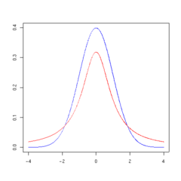
t-distribution
t-distribution: similar to the normal curve
Parameter defining its centre
Parameter defining its dispersion
Area under curve = probability of 1
We can ask the probability of getting a t-statistic of more than e.g. 2.13
Area under the relevant part of the curve
p = .041 (we can look this up in a table)
Red: t-distribution
Blue: normal distribution
p-value: keyconcept in statistics
Will come up constantly

Slide 70
How many tails
One tailed test
Use the area under one extreme (tail) of the curve
Only use if difference can only be in one direction
If the effect you measure could only be either more or less
Normal population
Sample of miners
But what if the effect can go either way?
This is true for the miners
The miners might be less stressed
OR
Normal population
Sample of miners

Slide 71
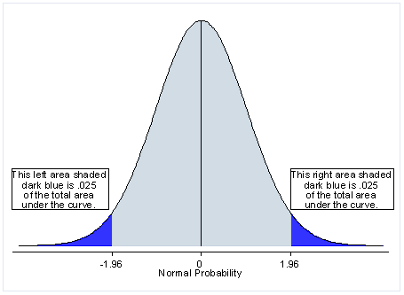
How many tails?
One tailed test
Use the area under one extreme (tail) of the curve
Only use if difference can only be in one direction
If the effect you measure could only be either more or less
Two tailed test
Use the area under both extremes of the curve
Use when difference can be in either direction
Use in most cases

Slide 72
What does the p-value mean again?
p-value means
Probability of getting a test statistic as high as we did, even though the null hypothesis is true
Probability of getting t = 2.13, even though the mean blood cortisol of the mine workers is not really higher than 23 mcg/dL
Probability of finding our effect due to chance in sampling – we might have just sampled the 16 most stressed by chance
p = .041 means there is a 4.1% chance of getting the mean we did, if the mine workers were not more stressed than normal
There is a 95.9% chance the miners stress levels are beyond the normal range
We can use this to tell us if the difference is statistically significant

Slide 73
What does statistically significant mean?
The p-value at which we reject the null hypothesis
Convention, p< .05, we reject the null hypothesis
We reject the null hypothesis when we get a test statistic that we would only expect to have a 95% chance of getting, if the null hypothesis were false
1 in 20 experiments will say there is a significant effect, even though there isn’t one!!!!!
Quantifying uncertainty – not certainty

Slide 74
General form of a test statistic
Effect we are measuring
Error related to sampling

Slide 75
Basic concepts in statistics
How are these represented as concepts in statistics
1) Frequency distributions and statistical parameters
2) Sampling distributions and sample statistics
3) The normal distribution as a parametric model
4) Hypothesis testing: z-scores, p-values, and test statistics
5) Paired and independent samples t-tests

Slide 76
…from yesterday…
Between subjects design
Within subjects design
Measure different subjects under different sets of conditions
E.g. compare effects of two drugs – different groups get different drugs
Independent samples t-test
Measure the same subjects under different sets of conditions
E.g. compare effect of two drugs – same group tested on each drug
Paired sample t-test

Slide 77
…from yesterday…
Between subjects design
Within subjects design
Measure different subjects under different sets of conditions
E.g. compare effects of two drugs – different groups get different drugs
Independent samples t-test
Measure the same subjects under different sets of conditions
E.g. compare effect of two drugs – same group tested on each drug
Paired sample t-test

Slide 78
A new scenario
Scenario:
Sociologist employed by a mining company to measure chronic stress among employees
New research question:
Does the shift a miner works on affect his/her stress levels?
Operational definition
Chronic stress is elevated levels of blood cortisol
Dependant variable
Blood cortisol in mcg/dL
A new null hypothesis
Night and day shift workers have the same blood cortisol levels
Night and day shift workers come from the same population (i.e. same parameters)
A new alternative hypothesis
Night and day shift workers have different blood cortisol levels
Night and day shift workers come from different populations
(i.e. different parameters)

Slide 79
Day shift
Night shift
Null hypothesis
Alternative hypothesis
How do we quantify this difference?
How do we test the alternative hypothesis?

Slide 80
Independent samples t-statistic
Mean of sample of night miners
Mean of sample of day workers
Difference between sample means
Estimation of how well the samples represents the two groups of miners
Square of the pooled variance divided by the number of subjects
Does the same thing as the standard error

Slide 81
…from yesterday…
Between subjects design
Within subjects design
Measure different subjects under different sets of conditions
E.g. compare effects of two drugs – different groups get different drugs
Independent samples t-test
Measure the same subjects under different sets of conditions
E.g. compare effect of two drugs – same group tested on each drug
Paired sample t-test

Slide 82
A new scenario
Scenario:
Sociologist employed by a mining company to measure chronic stress among employees
New research question:
Does increasing wages decrease miners stress?
Operational definition
Chronic stress is elevated levels of blood cortisol
Dependant variable
Blood cortisol in mcg/dL
A new null hypothesis
Miners have the same stress levels after a wage increase
Miners still come from the same population after a wage increase (i.e. same parameters)
A new alternative hypothesis
Miners have different stress levels after a wage increase
The wage increase means they come from a new population (i.e. different parameters)

Slide 83
Before wage increase
After wage increase
Null hypothesis
Alternative hypothesis
How do we quantify this difference?
How do we test the alternative hypothesis?

Slide 84
t-statistic
Difference between the two samples
Difference we would expect due to chance (i.e. null hypothesis)
Difference between samples minus expected difference
Estimation of how well the mean difference score represents the miners
Standard error of the differences

Slide 85
Basic concepts in statistics
How are these represented as concepts in statistics
1) Frequency distributions and statistical parameters
2) Sampling distributions and sample statistics
3) The normal distribution as a parametric model
4) Hypothesis testing: z-scores, p-values, and test statistics
5) Paired and independent samples t-tests

Slide 86
..today
Concept
Theory
Statistical model
Operational definition
Dependent variable measured in a sample
Sample
data
Sample
statistic
Population in real world
Hypothesis testing
Population at relevant times
“Reality”
Population statistic

Slide 87
The p ritual
Operationalise your concept
Formulate a research question
State the research question as an alternative hypothesis
State the complimentary null hypothesis
Measure a sample
Calculate a test statistic for the sample
Find a p-value for that test statistic
Accept or reject the null hypothesis based on the p-value
Retain the alternative hypothesis until the experiment is replicated
Proceed on the assumption that while the research question remains open, you have learned something about it

